Slide 1
Lecture 05 – Decision Trees
Dr. Khuram Shahzad
Thanks to: Dr. Faisal Shafait
Associate Professor
School of Electrical Engineering and Computer Science (SEECS)
National University of Sciences and Technology (NUST), Islamabad
https://www.coursera.org/learn/machine-learning

Slide 2
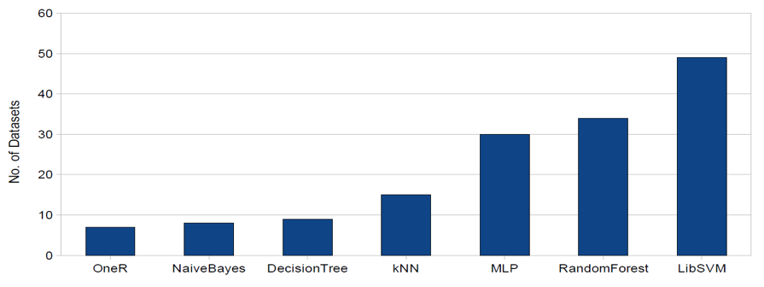
State-of-the-Art Classifiers
A classifier benchmarking experiment
103 datasets, 7 state-of-the-art classifiers

Slide 3

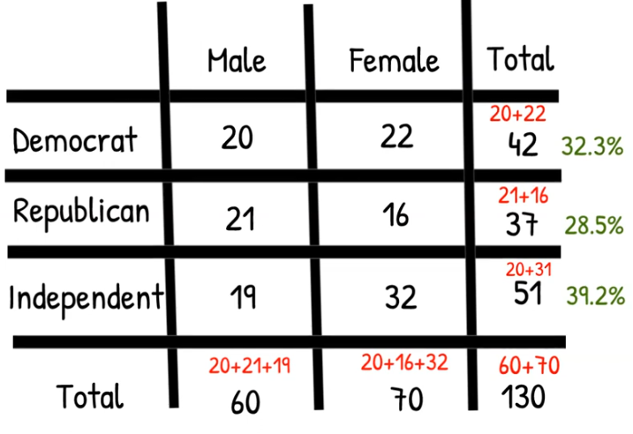
A contingency tables is special type of frequency distribution table, where at least two variables are shown simultaneouly. It displays frequencies for combinations of these variables. It is tabular representation of categorial data. Shows the frequencies for particular combination of two discrete random variables X and Y. The values at intersetion are unique frequencies for each combination of the two variables.
Contingency Tables
A contingency table:
Shows count for each set of responses in a two-dimensional survey
Marginal distributions:
Are percentage calculated from margins of our contingency table.

Slide 4
A 2-D Contingency Table
For each pair of values for attributes (no. of cylinders, mpg), we can see how many records match
No. of Cylinders | MPG good | MPG bad
3 | 0 | 0
4 | 17 | 4
5 | 0 | 1
6 | 0 | 8
7 | 0 | 0
8 | 1 | 9

Slide 5
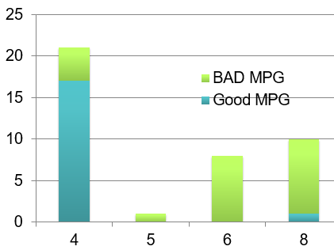
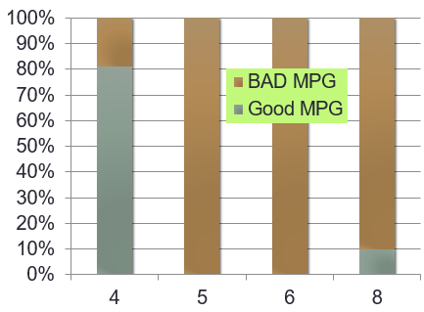
A 2-D Contingency Table
Easier to appreciate graphically
Easier to see patterns if we stretch out the histogram bars

Slide 6
How Many Contingency Tables?
With 7 attributes, how many 1-D contingency tables are there?
How many 2-D contingency tables?
How many 3-D contingency tables?
With 100 attributes how many 3-D contingency tables are there?

Slide 7
How Many Contingency Tables?
With 7 attributes, how many 1-D contingency tables are there? 7
How many 2-D contingency tables? 7-choose-2 = 7*6/2 = 21
How many 3-D contingency tables? 35
With 100 attributes how many 3-D contingency tables are there? 161,700
Which patterns are interesting?
Data mining!

Slide 8
Information Gain

Slide 9
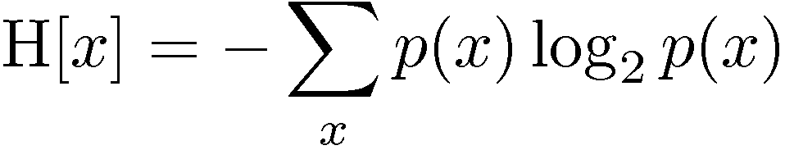
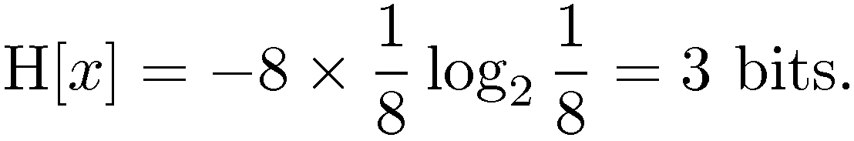
Entropy Revisited
Important quantity in coding theory, statistical physics, machine learning
Coding theory: x discrete with 8 possible states; how many bits to transmit the state of x?
All states equally likely

Slide 10
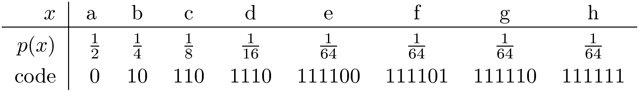
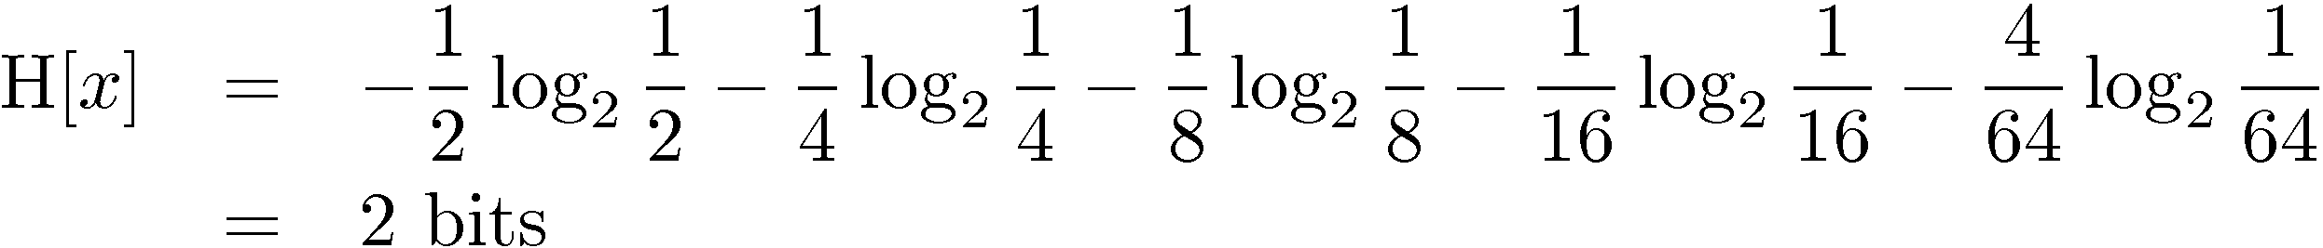
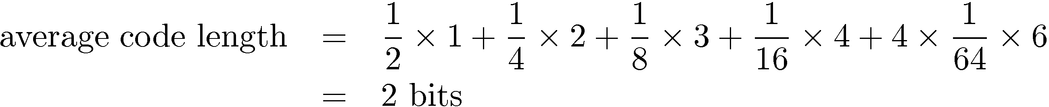
Entropy Revisited

Slide 11
Entropy Revisited
What does high entropy imply?
X is from a uniform (boring) distribution
A histogram of the frequency distribution of values of X would be flat
…. and so the values sampled from it would be all over the place
What does low entropy imply?
X is from a varied (peaks and valleys) distribution
A histogram of the frequency distribution of values of X would have many lows and one or two highs
…. and so the values sampled from it would be more predictable

Slide 12
Specific Conditional Entropy
Suppose we want to predict output Y given input X
H[Y] = 1
H[Y|X=v] = The entropy of Y among only those records in which X has value v
H[Y|X=5] = 1
H[Y|X=8] = 0
X = No. of cylinders
Y = MPG
X | Y
4 | Good
5 | Bad
4 | Good
8 | Bad
6 | Bad
5 | Good
4 | Good
4 | Bad

Slide 13

Information Gain
Conditional entropy H[Y|X] is the average specific conditional entropy of Y
Information Gain IG(Y|X) measures reduction in entropy of Y as a result of knowing the value of X

Slide 14
What is Information Gain used for?
Suppose we are trying to predict whether someone is going to live past 80 years.
From historical data we might find
IG(LongLife | HairColor) = 0.01
IG(LongLife | Smoker) = 0.2
IG(LongLife | Gender) = 0.25
IG(LongLife | DayOfBirth) = 0.00001
IG tells how interesting a 2-D contingency table is going to be

Slide 15
Learning a Decision Tree

Slide 16
Learning Decision Trees
A Decision Tree is a tree-structured plan of a set of attributes to test in order to predict the output.
Which attribute should be tested first? The one with the highest information gain
Then recurse ….

Slide 17
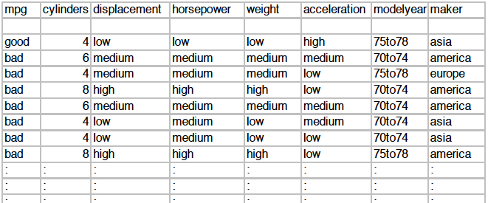
Example 1: MPG dataset from UCI (http://archive.ics.uci.edu/ml/)
Predict miles per gallon (MPG) given different attributes of a car

Slide 18
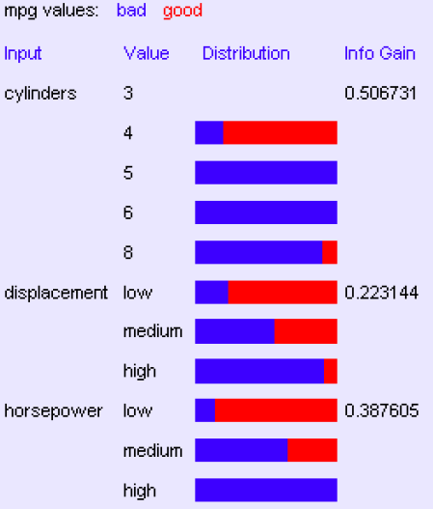
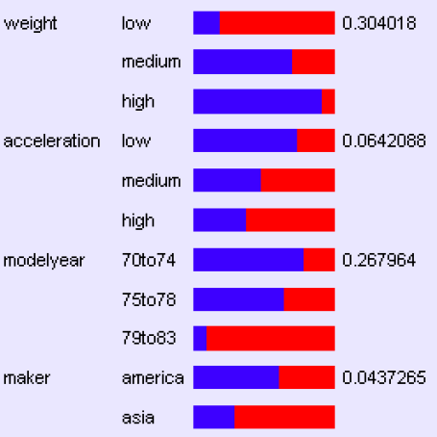
Compute IG of all Attributes

Slide 19
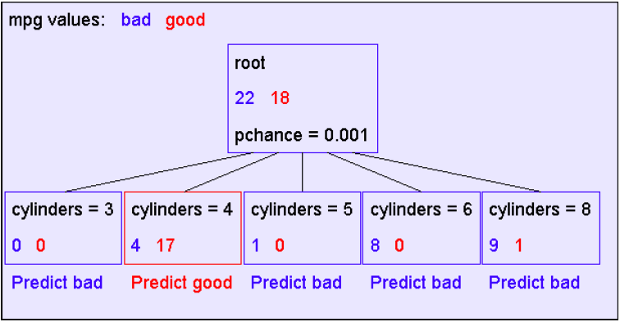
A Decision Stump

Slide 20
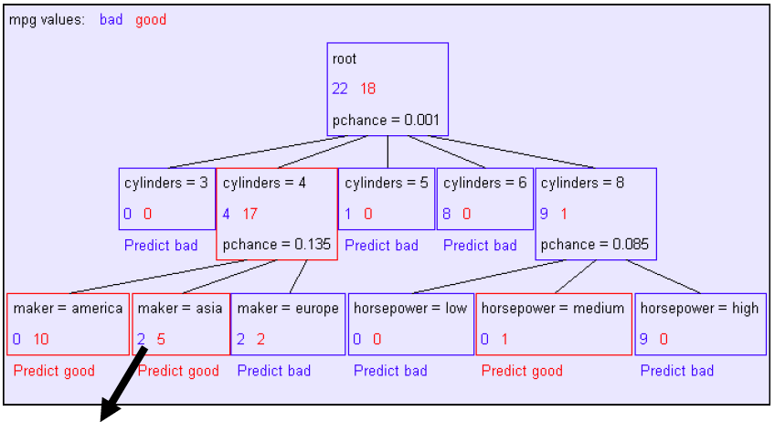
Recursion Step
Recursively build a tree from the seven records in which there are four cylinders and the maker was based in Asia
(Similar recursion in the other cases)

Slide 21
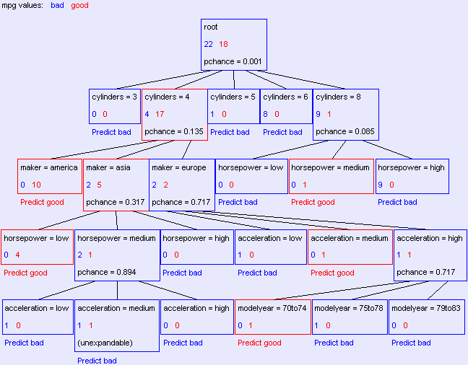
The Final Tree

Slide 22
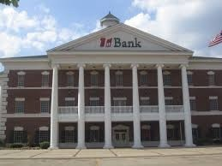

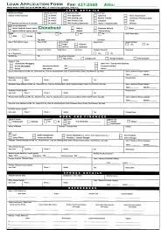




Example 2: What makes a loan risky?
I want a to buy a new house!
Credit History
★★★★
Income
★★★
Term
★★★★★
Loan
Application
Personal Info
★★★

Slide 23

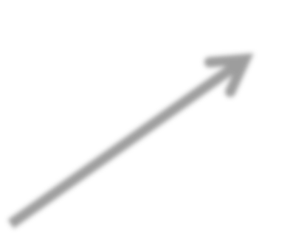
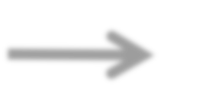
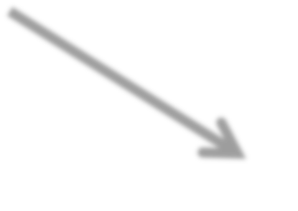

ŷ_{i} = +1
Loan Application
Classifier MODEL
Safe
Risky
Output: ŷ Predicted class
Input: x_{i}
ŷ_{i} = -1

Slide 24









Training data: N observations (x_{i},y_{i})
Assume N = 40, 3 features
Credit | Term | Income | y
excellent | 3 yrs | high | safe
fair | 5 yrs | low | risky
fair | 3 yrs | high | safe
poor | 5 yrs | high | risky
excellent | 3 yrs | low | risky
fair | 5 yrs | low | safe
poor | 3 yrs | high | risky
poor | 5 yrs | low | safe
fair | 3 yrs | high | safe
Optimize quality metric on training data
T(X)
Error = # incorrect predictions
# examples

Slide 25
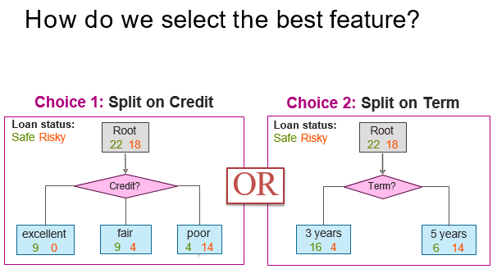
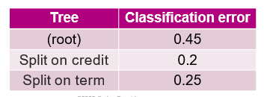

Slide 26
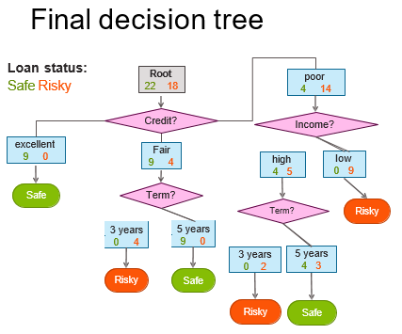

Slide 27
Decision Trees – Avoiding overfitting
Deep trees over-fit on the training data
Do not generalize well on new (unseen) data
Pruning is done to avoid over-fitting
Remove leaf nodes that have a high value of p-chance
p-chance determined through statistics (e.g. Chi-Squared Test)
Another way is to randomize learning, which is the principle behind Random Forests

Slide 28
Randomized Learning

Slide 29
Toy Learning Example
Try several lines, chosen at random
Keep line that best separates data
Information gain
Recurse
y
x
feature vectors are x, y coordinates: v = [x, y]^{T}
split functions are lines with parameters a, b: f_{n}(v) = ax + by
threshold determines intercepts: t_{n}
four classes: purple, blue, red, green

Slide 30
Toy Learning Example
Try several lines, chosen at random
Keep line that best separates data
Information gain
Recurse
y
x
feature vectors are x, y coordinates: v = [x, y]^{T}
split functions are lines with parameters a, b: f_{n}(v) = ax + by
threshold determines intercepts: t_{n}
four classes: purple, blue, red, green

Slide 31
Toy Learning Example
Try several lines, chosen at random
Keep line that best separates data
Information gain
Recurse
y
x
feature vectors are x, y coordinates: v = [x, y]^{T}
split functions are lines with parameters a, b: f_{n}(v) = ax + by
threshold determines intercepts: t_{n}
four classes: purple, blue, red, green

Slide 32
Toy Learning Example
y
Try several lines, chosen at random
Keep line that best separates data
Information gain
Recurse
x
feature vectors are x, y coordinates: v = [x, y]^{T}
split functions are lines with parameters a, b: f_{n}(v) = ax + by
threshold determines intercepts: t_{n}
four classes: purple, blue, red, green

Slide 33
Implementation Details
How many features and thresholds to try?
just one = “extremely randomized”
few -> fast training, may under-fit, maybe too deep
many -> slower training, may over-fit
When to stop growing the tree?
maximum depth
pruning

Slide 34
Random Forests

Slide 35
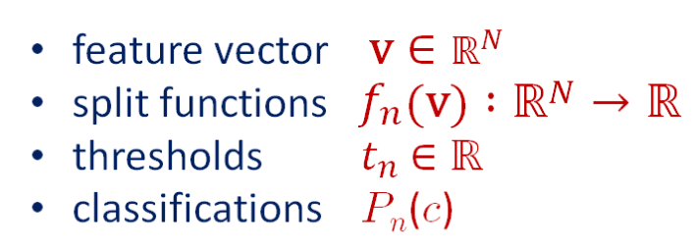
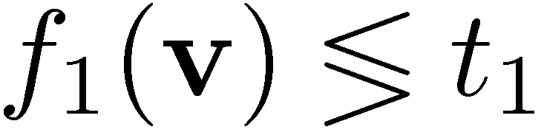
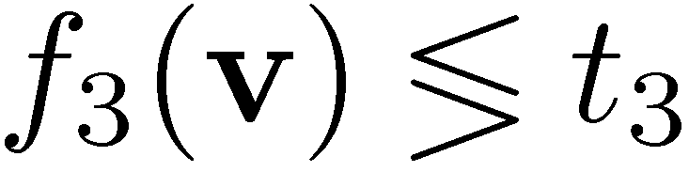
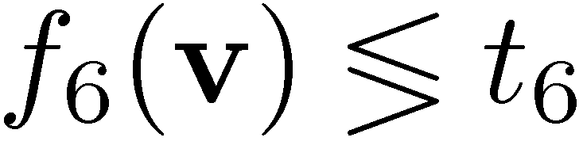
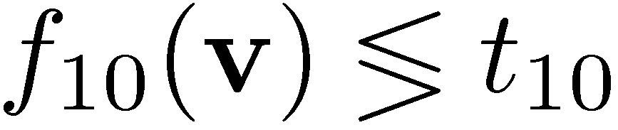

leaf nodes
v
split nodes
1
≥
2
3
<
4
5
6
7
<
8
9
10
11
12
13
≥
14
15
16
17
category c

Slide 36


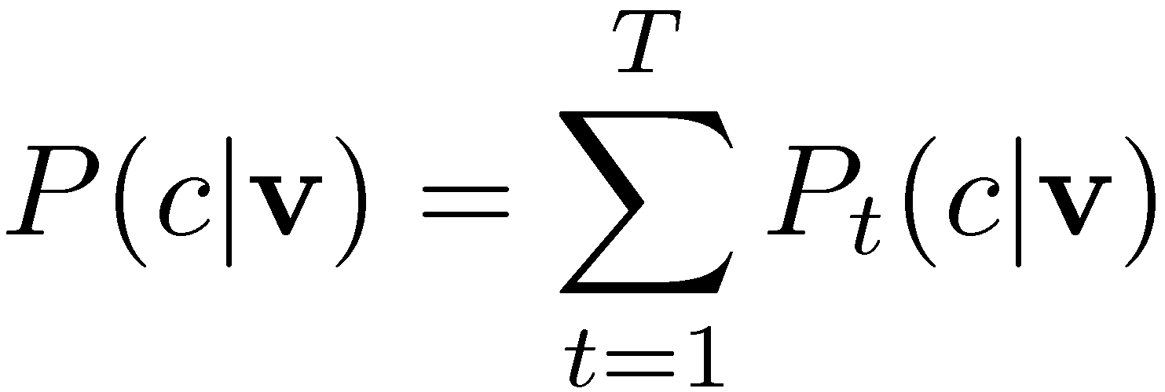
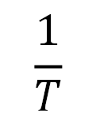
Random Forests - A Forest of Trees
v
leaf nodes
v
split nodes
tree t₁
tree t_{T}
……
category c
category c
[Amit & Geman 97]
[Breiman 01]
[Lepetit et al. 06]
$$\frac{1}{T}$$

Slide 37
Learning a Forest
Divide training examples into T subsets I_{t} µ I
improves generalization
reduces memory requirements & training time
Train each decision tree t on subset I_{t}
same decision tree learning as before
Multi-core friendly
Subsets can be chosen at random or hand-picked
Subsets can have overlap (and usually do)
Could also divide the feature pool into subsets

Slide 38
Strengths of Random Forests
Based on Decision Trees
[Explainability of classification results]
Extremely fast: Test attribute values one at a time
Randomized training
Built in feature selection
Can handle very large datasets
Bagging (collecting results from multiple decision trees)
Built in regularization
Favorite classifier for real-time applications

